Slide 1
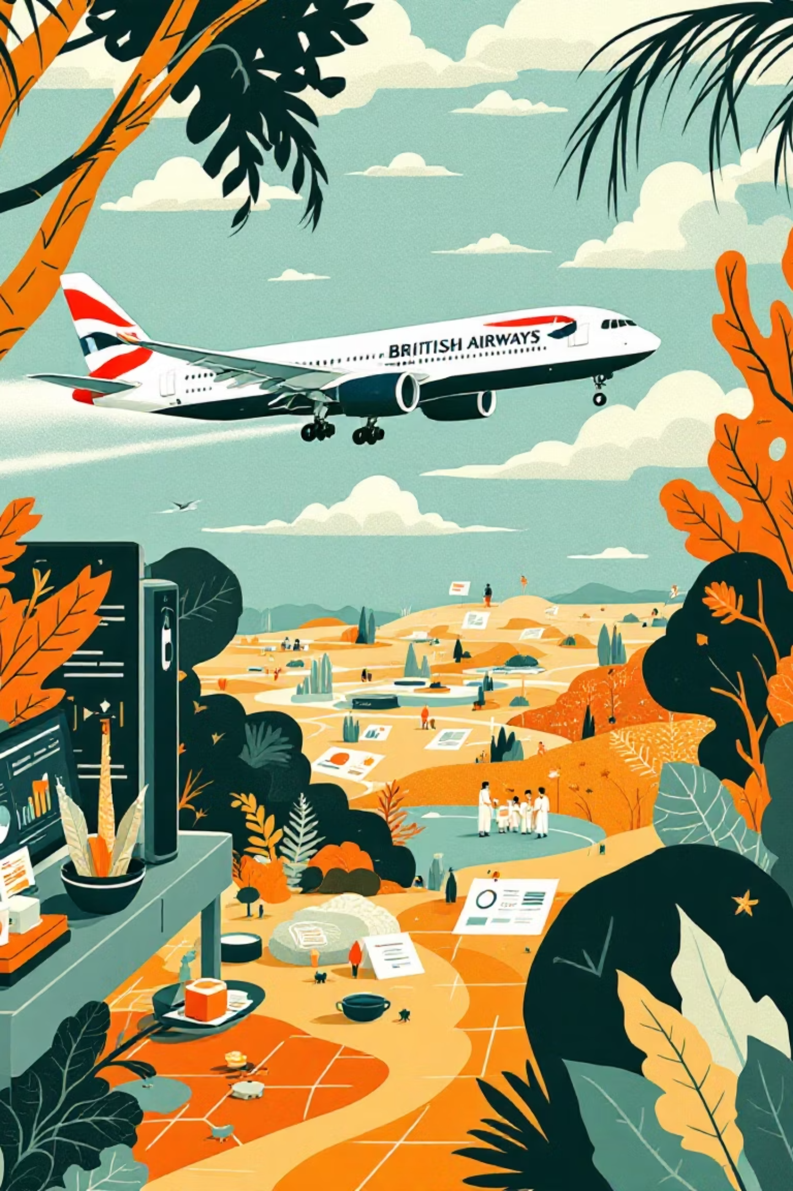
Maximizing Revenue by Predicting Customer Booking Behavior
From Accuracy Trap to Revenue-Focused Machine Learning
British Airways – Customer Analytics | ML Project

Slide 2
1. Business Problem
Only 15% of users complete a booking
Prediction task is highly imbalanced
Goal: Identify high-value customers early to maximize revenue

Slide 3
2. The Accuracy Trap
Baseline model achieved 85% accuracy
Predicted “No Booking” for most users
Recall ≈ 14%
Missed 86% of actual bookers
Key Insight: High accuracy ≠ Business value

Slide 4

3. Data Preparation & Feature Engineering
Created intent-based features:
Encoded booking origin & flight day
Length of stay
Reduced features from 124 → 62
Weekend flight indicator
Extras selected
Stay per flight hour

Slide 5



4. Solution Strategy
Applied SMOTE to balance booking customers
Upgraded model: Random Forest → XGBoost
XGBoost chosen for:
Sequential error learning
Strong tabular performance
Better stability

Slide 6
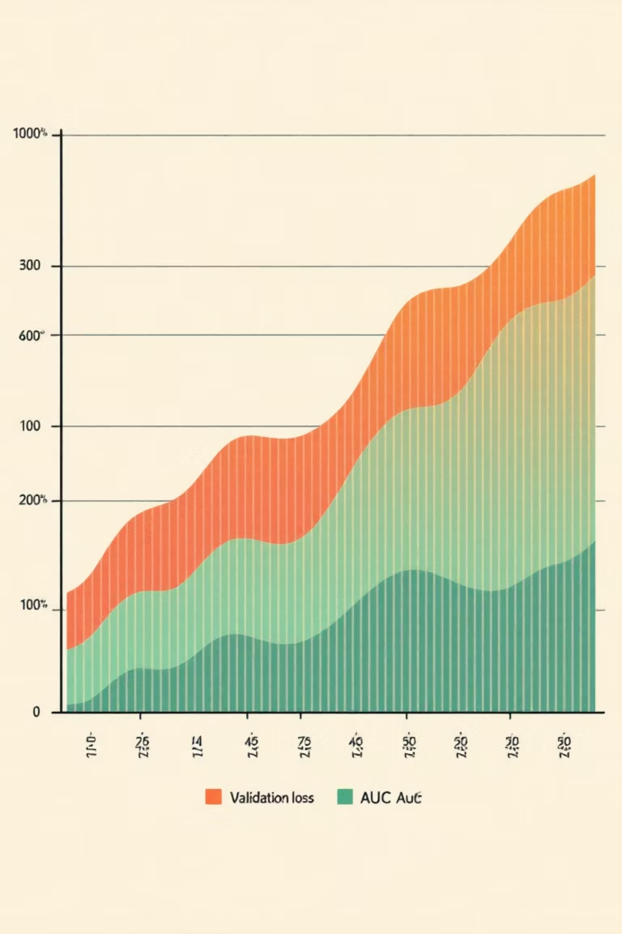
5. Model Training & Stability
Log-loss decreased smoothly
Validation AUC increased consistently
Train AUC: 0.94
📊 [Insert Training vs Test Loss & AUC Plots Here]
Test AUC: 0.786
CV AUC: 0.76

Slide 7
6. Final Model Performance (Threshold = 0.30)
0.786
80%
53%
37%
ROC-AUC
Accuracy
Recall (Booking)
Precision (Booking)
Trade-off: Lower accuracy → higher revenue capture

Slide 8
7. From Passive to Targeted Predictions
01
02
03
Default threshold missed bookers
Optimized threshold = 0.30
Model now actively identifies high-intent users
Business View: False negatives are costlier than false positives

Slide 9
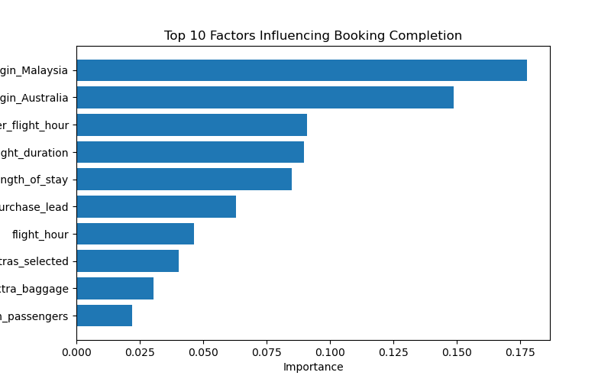
8. What Drives Bookings?
Top Predictors:
Booking origin (Malaysia, China, Australia)
Length of stay
Weekend & specific flight days
Extras selected
Route popularity

Slide 10
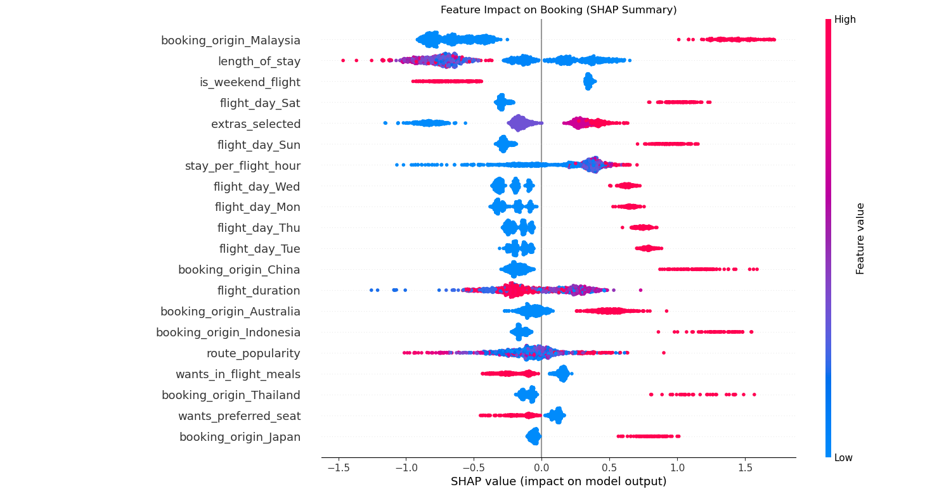
9. Model Explainability (SHAP)
SHAP explains why a customer is flagged
Weekend travel + extras → strong positive impact
Longer stays → higher booking probability

Slide 11
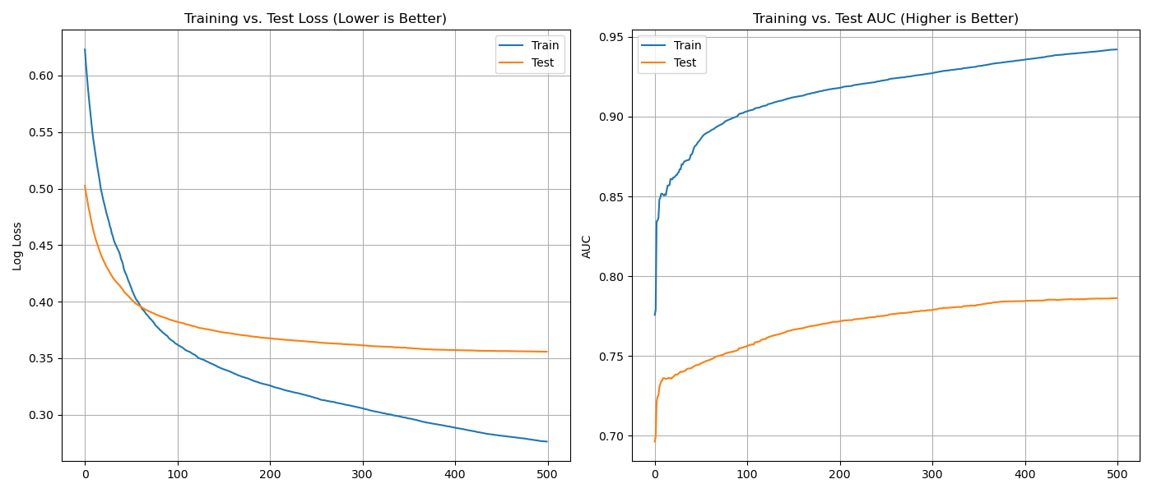

Slide 12
Business Impact & Takeaway
Target top 30% high-probability users
Reduce missed high-value customers
Improve marketing ROI
We transformed a model that was “accurate but useless” into a revenue-focused engine.

